Slide 1

Machine Learning
In a simple words
Using data to answer questions
Machine learning (ML) is generally understood as the ability of the system to make predictions or draw conclusions based on the analysis of a large historical data set.

Slide 2
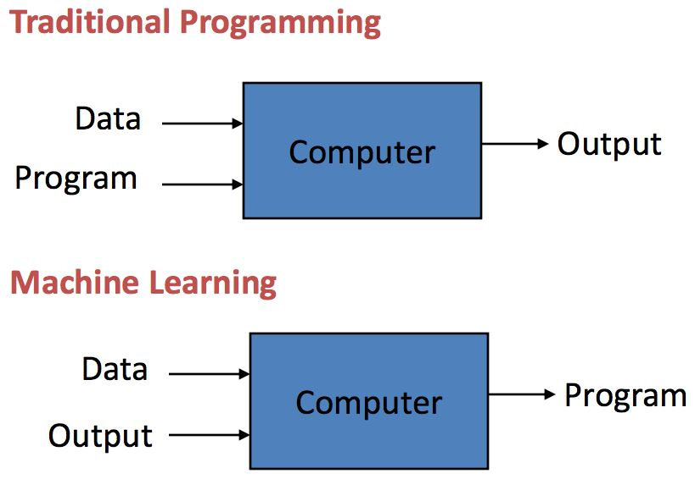
Machine Learning

Slide 3
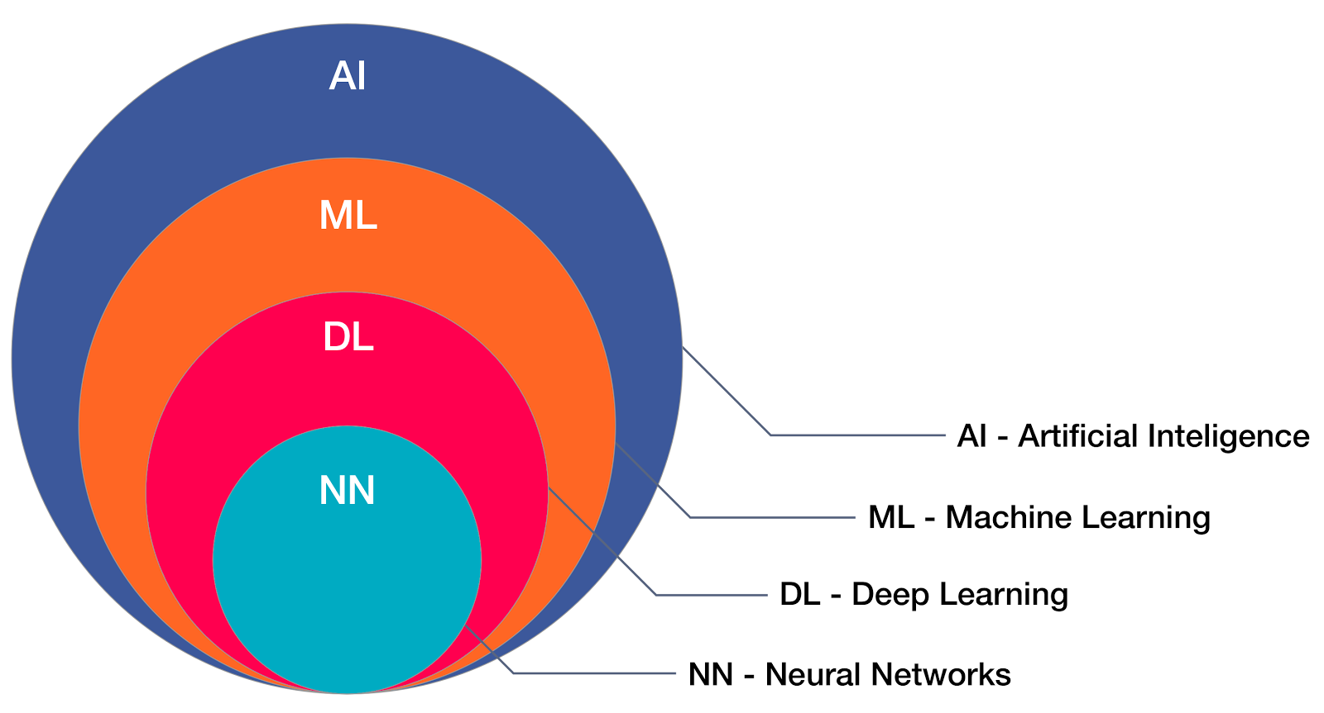
About AI/ML/DL/NN

Slide 4
Artificial intelligence
Artificial intelligence is the making the machines basically computer systems intelligent like it should able to act like humans.
Types of AI:
Weak AI. it is focusing on a single task only. As from the name, it is clear, it has a narrow range of abilities to perform any task.
Examples: Alexa
General AI. General AI is a type of intelligence which could perform any intellectual task with efficiency like a human. t has not developed yet properly.
Super AI : It is the type under assumption which is more than human’s thinking. It means when there is so much good decision-making capability with robots and they are able to perform any kind of task.

Slide 5
About AI/ML/DL/NN
Machine Learning is the subset of Artificial Intelligence which deals with the extraction of patterns from data sets.
Deep Learning is a subfield of machine learning concerned with algorithms inspired by the structure and function of the brain called artificial neural networks.
Neural Networks is made of an assortment of algorithms that are modelled on the human brain. These algorithms can interpret sensory data via machine perception and label or cluster the raw data.
Data Science is made association with all NN,DL,ML and AI along with the mathematical tools like statistics, probability, linear algebra, Differtial calculus.

Slide 6
Types of Machine Learning
Machine Learning Algorithms are mainly divided into 3 categories.
Supervised Learning
Unsupervised Learning
Reinforcement Learning
Supervised Learning : Supervised Learning is a learning which we train the machine using data which is labelled.(some data is already tagged with the correct answer). After that, the machine is provided with a new set of examples(data) so that supervised learning analyze the training data(set of training examples) and produces correct outcome from labelled data.

Slide 7
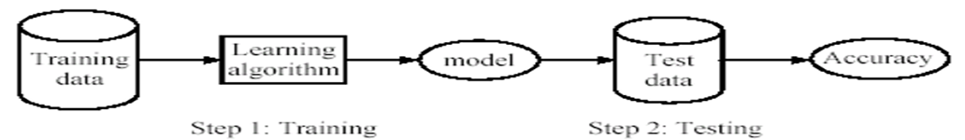
Supervised Learning
Learning(Training): Learn a model using the training data.
Testing : Test the model using unseen test data to access the model accuracy.
Accuracy = Number of correct classifications / Total number of test cases

Slide 8
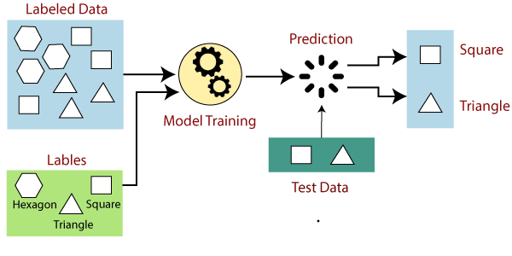
Supervised Learning
Example

Slide 9
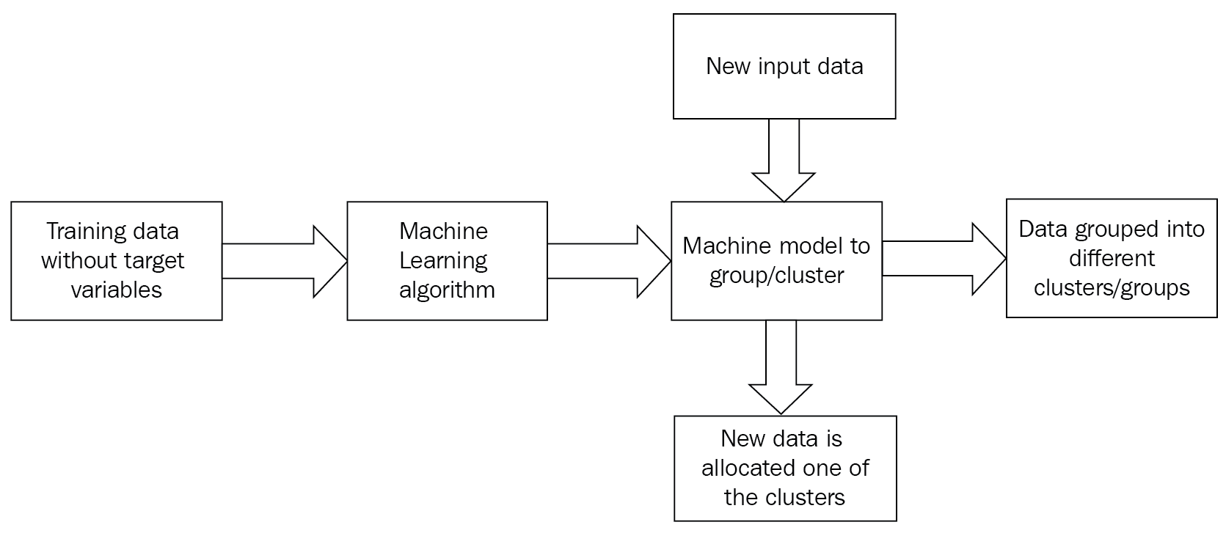
Un Supervised Learning
Training of machine using information that is neither classified nor labeled and allowing the algorithm to act on that information with out guidance. Here the task of machine is to group unsorted according to similarities, patterns, and differences without any prior training of data.

Slide 10
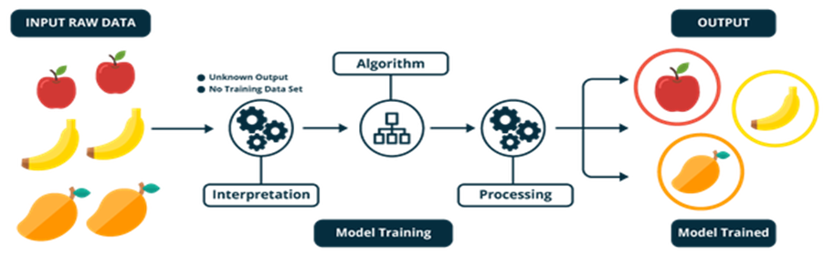
Un Supervised Learning
Example

Slide 11
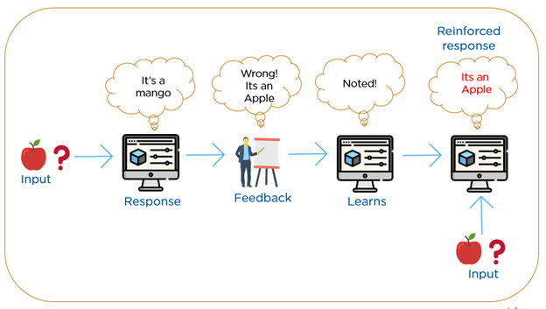
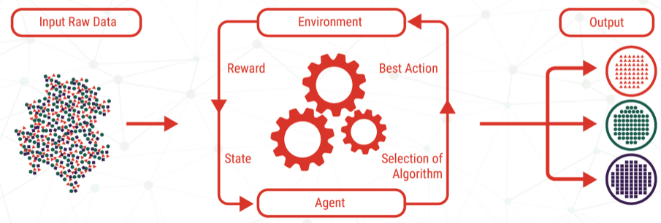
Reinforcement Learning
Reinforcement Learning is a type of Machine Learning used extensively in Artificial Intelligence. Put simply, it is all about learning through experience.

Slide 12
Supervised Learning and Un Supervised learning
Supervised learning is further divided into two categories.
Classification: A classification problem is when the output variable is a category, such as “red” or “blue” or “disease” and “no disease”.
Regression: A regression problem is when the output variable is a real value, such as “dollars” or “weight”.
Un Supervised learning is further divided into two categories.
Clustering: A clustering problem is where you want to discover the inherent groupings in the data, such as grouping customers by purchasing behavior.
Association: An association rule learning problem is where you want to discover rules that describe large portions of your data, such as people that buy X also tend to buy Y.

Slide 13
Machine Learning Algorithms
Supervised learning |  | Un Supervised learning |  | Reinforcement learning
Classification | Regression | Clustering | Association
Logistic Regression | Linear Regression | Partitioning Methods | Apriori Algorithm
Decision Tree | Decision Tree | Hierarchical Clustering
SVM(Support Vector Machine) | SVM | Fuzzy Clustering
KNN | KNN | Density based Clustering
Random Forest | Random Forest | Model Based Clustering
Naïve Bayes |  | K-Means

Slide 14
scikit-learn
scikit-learn is an open source Python library for machine learning. Scikit-learn helps in preprocessing, dimensionality reduction(parameter selection), classification, regression, clustering, and model selection.
The library supports state-of-the-art algorithms such as KNN, random forest, SVM among others. It is built on top of Numpy.
scikit-learn comes with a few standard datasets, for instance the iris and digits datasets for classification and the boston house prices dataset for regression.
Installing scikit-learn for python
pip install scikit-learn

Slide 15
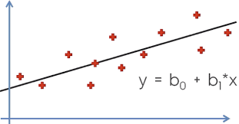
Linear regression
Linear regression is a linear approach to modeling the relationship between a scalar response and one or more explanatory variables.
There are two types of linear regression- Simple and Multiple.
x – independent variable(Input)
Y – dependent variable(output)
b₁ - slope
b₀ - constant

Slide 16
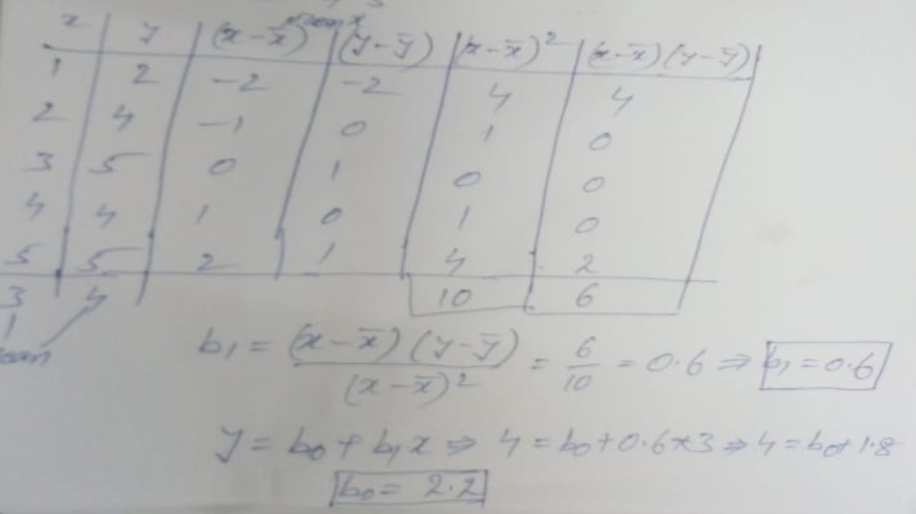
Linear regression

Slide 17
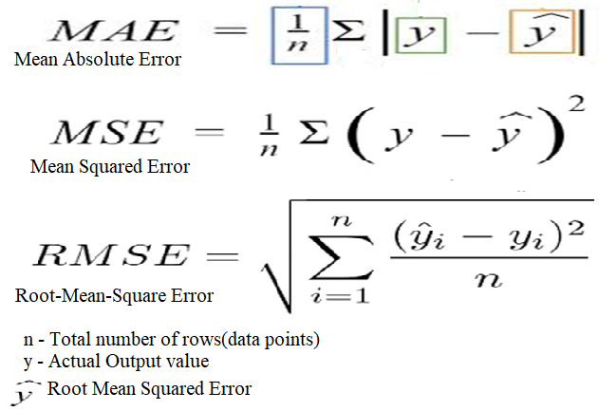
Linear regression

Slide 18
Multi Linear Regression
Y = b₀+b₁x₁+b₂x₂+----------+b_{n}x_{n}
Where
Y is the independent value (Predicted Value)
b₀ is the intercept of Y
b₁ Is the slope
x₁ is the dependent values (Data values

Slide 19
Multi Linear Regression
To perform Backward Elimination, we have to install libraries
pip install statsmodels
pip install patsy

Slide 20


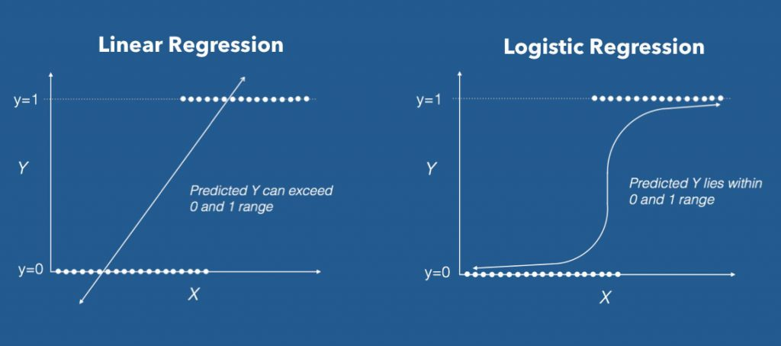
Logistic regression
Logistic regression is a statistical method for predicting binary classes. The outcome or target variable is binary in nature. For example, it can be used for cancer detection problems. It computes the probability of an event occurrence.
Sigmoid Function

Slide 21
Logistic regression
Examples of Logistic regression:
Mail spam detection
Tumour Prediction
Customer will buy insurance or not
For which party voter will vote(BJP, Congress, 3rd front)

Slide 22
Logistic regression
Types of Logistic regression
There are 2 types of classifications in Logistic regression
Binary classification(Binomial)
Multiclass classification(Multinomial)

Slide 23
Decision Tree Algorithm
The decision tree algorithm creates a model that predicts the value of a target variable by learning simple decision rules inferred from the data features.
Decision tree algorithm falls under the category of supervised learning. They can be used to solve both regression and classification problems.
Decision trees are based on the type of target variable we have. It can be of two types:
Categorical Variable Decision Tree: Decision Tree which has a categorical target variable then it called a Categorical variable decision tree.
Continuous Variable Decision Tree: Decision Tree has a continuous target variable then it is called Continuous Variable Decision Tree.

Slide 24
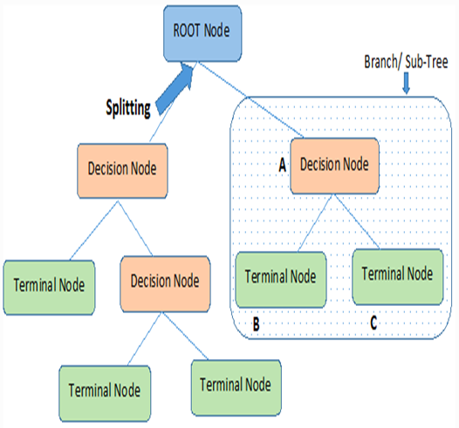
Decision Tree Algorithm
Terminology - Decision Trees
Root Node: It represents the entire population or sample and this further gets divided into two or more homogeneous sets.
Splitting: process of dividing a node into two or more sub-nodes.
Decision Node: When a sub-node splits into further sub-nodes, then it is called the decision node.
Leaf / Terminal Node: Nodes do not split is called Leaf or Terminal node.
Pruning: When we remove sub-nodes of a decision node, this process is called pruning. You can say the opposite process of splitting.
Branch / Sub-Tree: A subsection of the entire tree is called branch or sub-tree.
Parent and Child Node: A node, which is divided into sub-nodes is called a parent node of sub-nodes whereas sub-nodes are the child of a parent node.

Slide 25
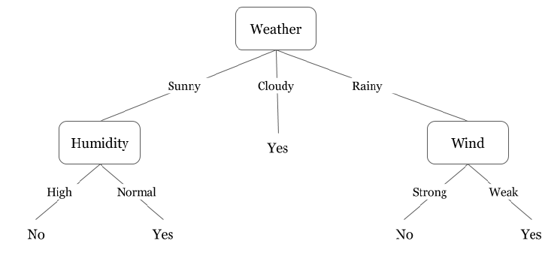
Decision Tree Algorithm
Example:
Day | Weather | Temperature | Humidity | Wind | Play?
1 | Sunny | Hot | High | Weak | No
2 | Cloudy | Hot | High | Weak | Yes
3 | Sunny | Mild | Normal | Strong | Yes
4 | Cloudy | Mild | High | Strong | Yes
5 | Rainy | Mild | High | Strong | No
6 | Rainy | Cool | Normal | Strong | No
7 | Rainy | Mild | High | Weak | Yes
8 | Sunny | Hot | High | Strong | No
9 | Cloudy | Hot | Normal | Weak | Yes
10 | Rainy | Mild | High | Strong | No

Slide 26
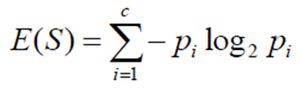
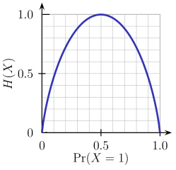
Decision Tree Algorithm
Entropy:
Entropy measures the purity of the split. measure of the randomness in the information being processed. The higher the entropy, the harder it is to draw any conclusions from that information.
S → Current state
Pi → Probability of an event i of state S

Slide 27
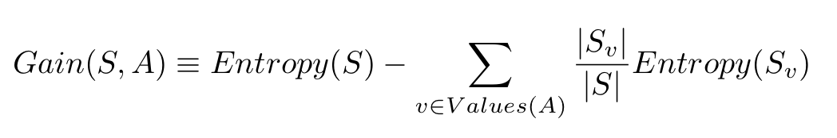
Decision Tree Algorithm
Information Gain
Information gain or IG is a statistical property that measures how well a given attribute separates the training examples according to their target classification. Constructing a decision tree is all about finding an attribute that returns the highest information gain and the smallest entropy
S

Slide 28
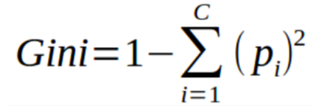
Decision Tree Algorithm
Gini Index
The Gini Index is calculated by subtracting the sum of the squared probabilities of each class from one. It favors larger partitions.
P--Probability of +ve and -ve

Slide 29
Decision Tree Algorithm
Bias Error
Bias are the simplifying assumptions made by a model to make the target function easier to learn.
Low Bias: Suggests less assumptions about the form of the target function.
High-Bias: Suggests more assumptions about the form of the target function.
Examples of low-bias machine learning algorithms include: Decision Trees, k-Nearest Neighbors and Support Vector Machines.
Examples of high-bias machine learning algorithms include: Linear Regression, and Logistic Regression.

Slide 30
Decision Tree Algorithm
Variance Error
Variance is the amount that the estimate of the target function will change if different training data was used.
The target function is estimated from the training data by a machine learning algorithm, so we should expect the algorithm to have some variance
Machine learning algorithms that have a high variance are strongly influenced by the specifics of the training data. This means that the specifics of the training have influences the number and types of parameters used to characterize the mapping function.
Low Variance: Suggests small changes to the estimate of the target function with changes to the training dataset.
High Variance: Suggests large changes to the estimate of the target function with changes to the training dataset.
Low-variance algorithms Examples : Linear Regression, Linear Discriminant Analysis and Logistic Regression.
High-variance algorithms Examples : Decision Trees, k-Nearest Neighbors and Support Vector Machines.

Slide 31
Ensemble methods
Ensemble methods is a machine learning technique that combines several base models in order to produce one optimal predictive model.
Types of Ensemble methods
Bagging(Bootstrap Aggregation)
Boosting – Ada Boost, Gradient Boost, Xg Boost

Slide 32
Ensemble methods - Bagging
Dataset
testset
Row sampling with Replacement
Set1
Set2
Set3
Set4
Set5
Aggregation
1
1
1
1
1
result

Slide 33
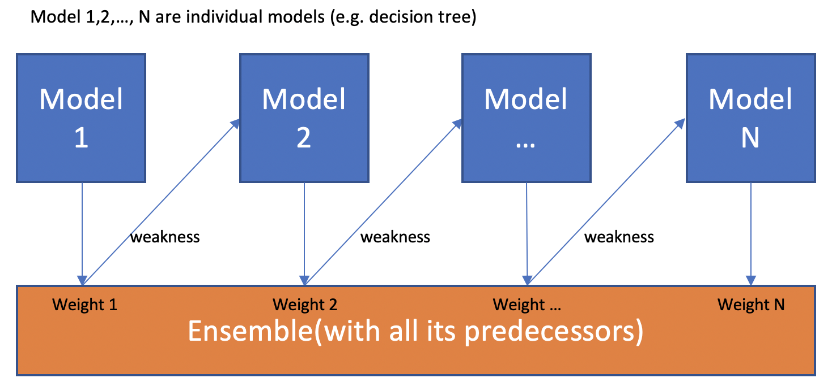
Ensemble methods - Boosting

Slide 34
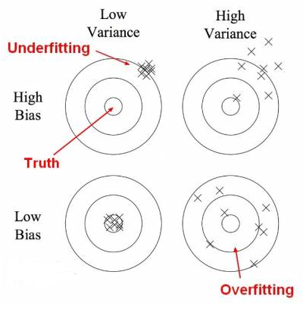
Decision Tree Algorithm

Slide 35
Decision Tree Algorithm
Dataset
testset
Set1
Set2
Set3
Set4
Set5
1
1
1
1
1
result

Slide 36
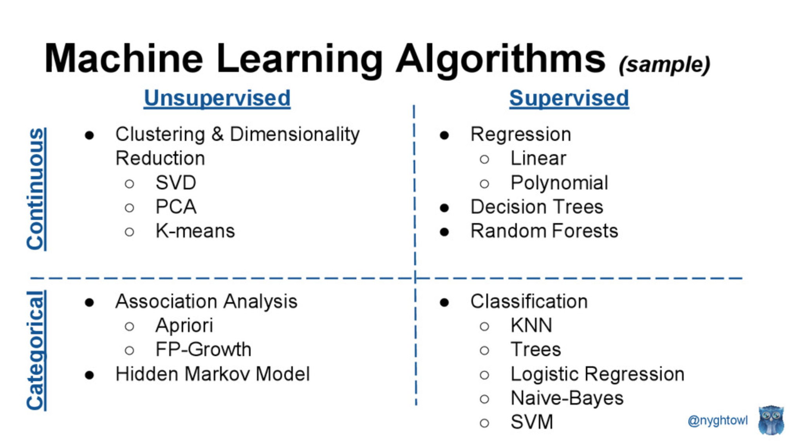

Slide 37
